Slide 1
Creating and Displaying Many elements
Info 5100 – Application Engineering and Development
Dr. Kal Bugrara

Slide 2
The problem
Businesses sell products to customers.
They must organize their products so customers know about them in terms of features, availability, and price.
Sometimes, new products get added, discontinued, updated, etc.
Business need software to help them managing their products (product catalog).

Slide 3
Objective
Build a business application to help companies manage their products

Slide 4
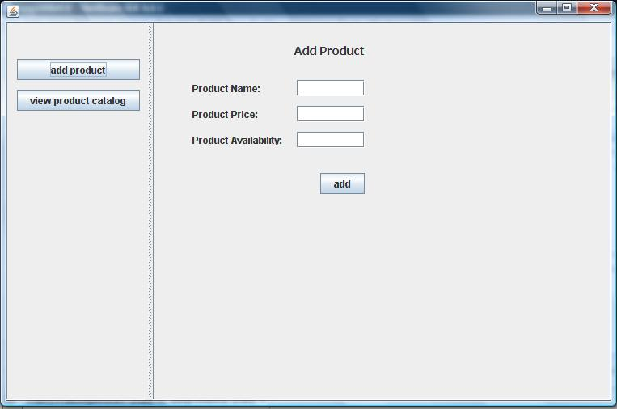
The Application: Add Product

Slide 5
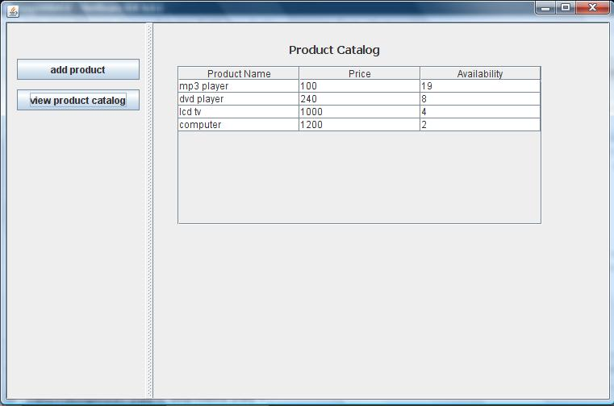
The Application: Browse products

Slide 6
Key Question: How to organize the products?
We know how to keep track of a single product through a reference variable, but what if we have many products?
Where to keep the products?
How find an existing product?
How to list them?

Slide 7
The answer: Build an information model first
Dell Laptop
MacBook
Toshiba 101
HP Light Laptop

Slide 8
We have a collection of products: The product catalog
HP Laptop
MacBook
Toshiba 101
Product Catalog is the container of the products
Product

Slide 9
Operations on product catalog
Add
Remove
HP Laptop
MacBook
Toshiba 101
Product Catalog
Product Catalog
MacBook
HP Laptop
Toshiba 101

Slide 10
So what is the information model for the product catalog?
Is it
Product
Catalog
Or
Product

Slide 11
Product catalog keeps track of products
Or
Catalog has products
Flight
Schedule
Flight
Relationship

Slide 12
Product catalog keeps track of products
Relationship connections give meaning to
concepts:
Product
Catalog
Catalog has products
Product
Product belongs to catalog

Slide 13
Product catalog keeps track of products (manages products)
Product
Catalog
Product
Product group info goes here
Product info goes here
Group specific and does not care about details of individual products: Its responsibilities include:
Creating new products
Add a product to the current list
Find and remove from the list
Find and update a specific product
Specific to a product like its price, avail, desc, etc.

Slide 14
Other Catalog Patterns (AKA factory pattern)
Catalog
Resource
Pattern
Example
Course
Catalog
Course
Car
Catalog
Car

Slide 15
Other Catalog Patterns (AKA factory pattern)
Patient Visit
History
Visit
Pattern
Example
Course
Schedule
Scheduled
Course
Medication
History
Medication

Slide 16
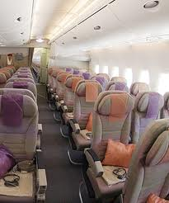
Other Catalog Patterns (AKA factory pattern)
Fleet
Aircraft
Flight
Schedule
Flight
Pattern
Example
Flight
Seat
Flight

Slide 17
Fleet
Aircraft
Flight
Schedule
Flight
Pattern
Example
Flight
Seat
Flight

Slide 18
Fleet
Aircraft
Flight
Schedule
Flight
Pattern
Example
Flight
Seat

Slide 19
Patient
Patient Visit
History
Visit
Model
Joe the Patient
Anna the Patient
Instances
Instances
Visit History
Visit
History
Visit
2010A
Visit
2010B
Visit 2011
Visit
2012
Visit
2008
Visit
2009
Visit 2011A
Visit
2011B

Slide 20
Airplane
Flight
Schedule
*
Flight
Model
1
* Zero to many
Boeing 787
Airbus A340
Instances
Instances
Flight Schedule
Flight Schedule
Berlin
20A
London
010B
Rome 211
London
012
Boston 2021
Wash
209
LA
201A
SF
2011B

Slide 21
Fleet
Airplane
Flight
Schedule
Flight
Model
Jet Blue Fleet
Boeing 787
Airbus A340
Boeing 777
Flight Schedule
Flight Schedule
Flight Schedule
Berlin
20A
London
010B
Rome 211
London
012
Wash
209
LA
201A
SF
2011B
Miami 2021
Dalas
209
Atlanta
201A

Slide 22
Jet Blue Fleet
Model
Boeing 787
Airbus A340
Boeing 777
Flight Schedule
Flight Schedule
Flight Schedule
Berlin
20A
London
010B
Rome 211
London
012
Wash
209
LA
201A
SF
2011B
Miami 2021
Dalas
209
Atlanta
201A

Slide 23
How Java will do this?
Classes so we define what each class means (for example flight handles the smarts of how to deal with empty and available seats)
Objects so we fill them with data that distinguish things
Array Lists to do two things
glue objects together

Slide 24
How Java will do this?
Arrays to do two things
glue components together
Relate one component to many components
For example an array is needed
a flight to house many empty seats
Medication history to keep track of multiple medications for a patient

Slide 26
How to implement this pattern in java?
Product
Catalog
Product
Define Java class for the product catalog
Define a java class for product
The product catalog class must keep track of products
How?

Slide 27
Why learning how to implement relationship connections are important?

Slide 28
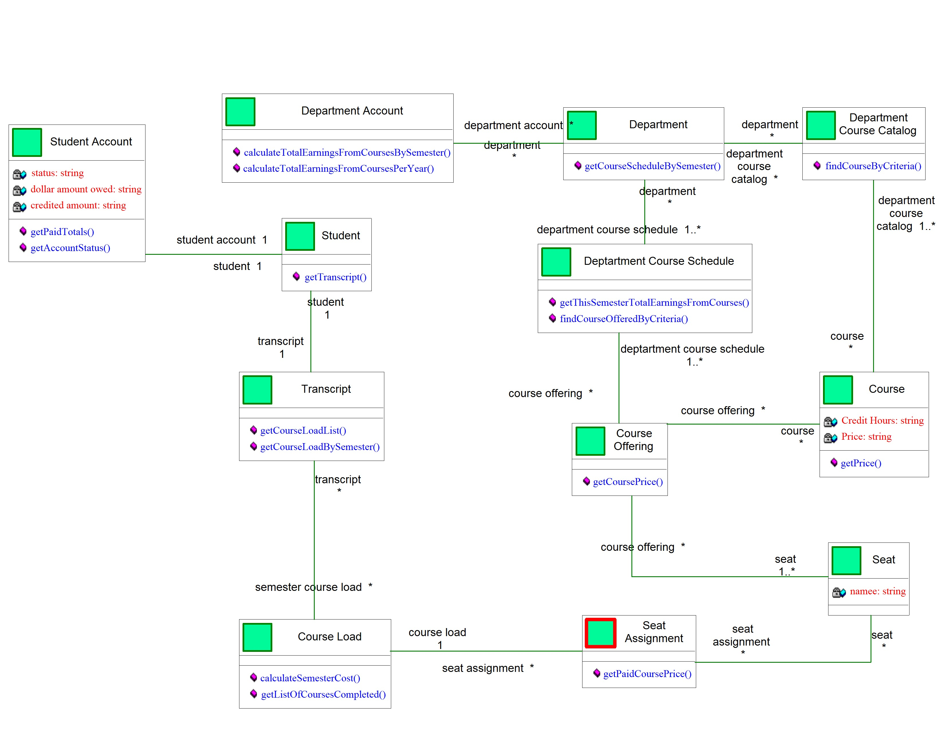
Student related questions start here

Slide 29
Department related questions start here
Student related questions start here

Slide 30
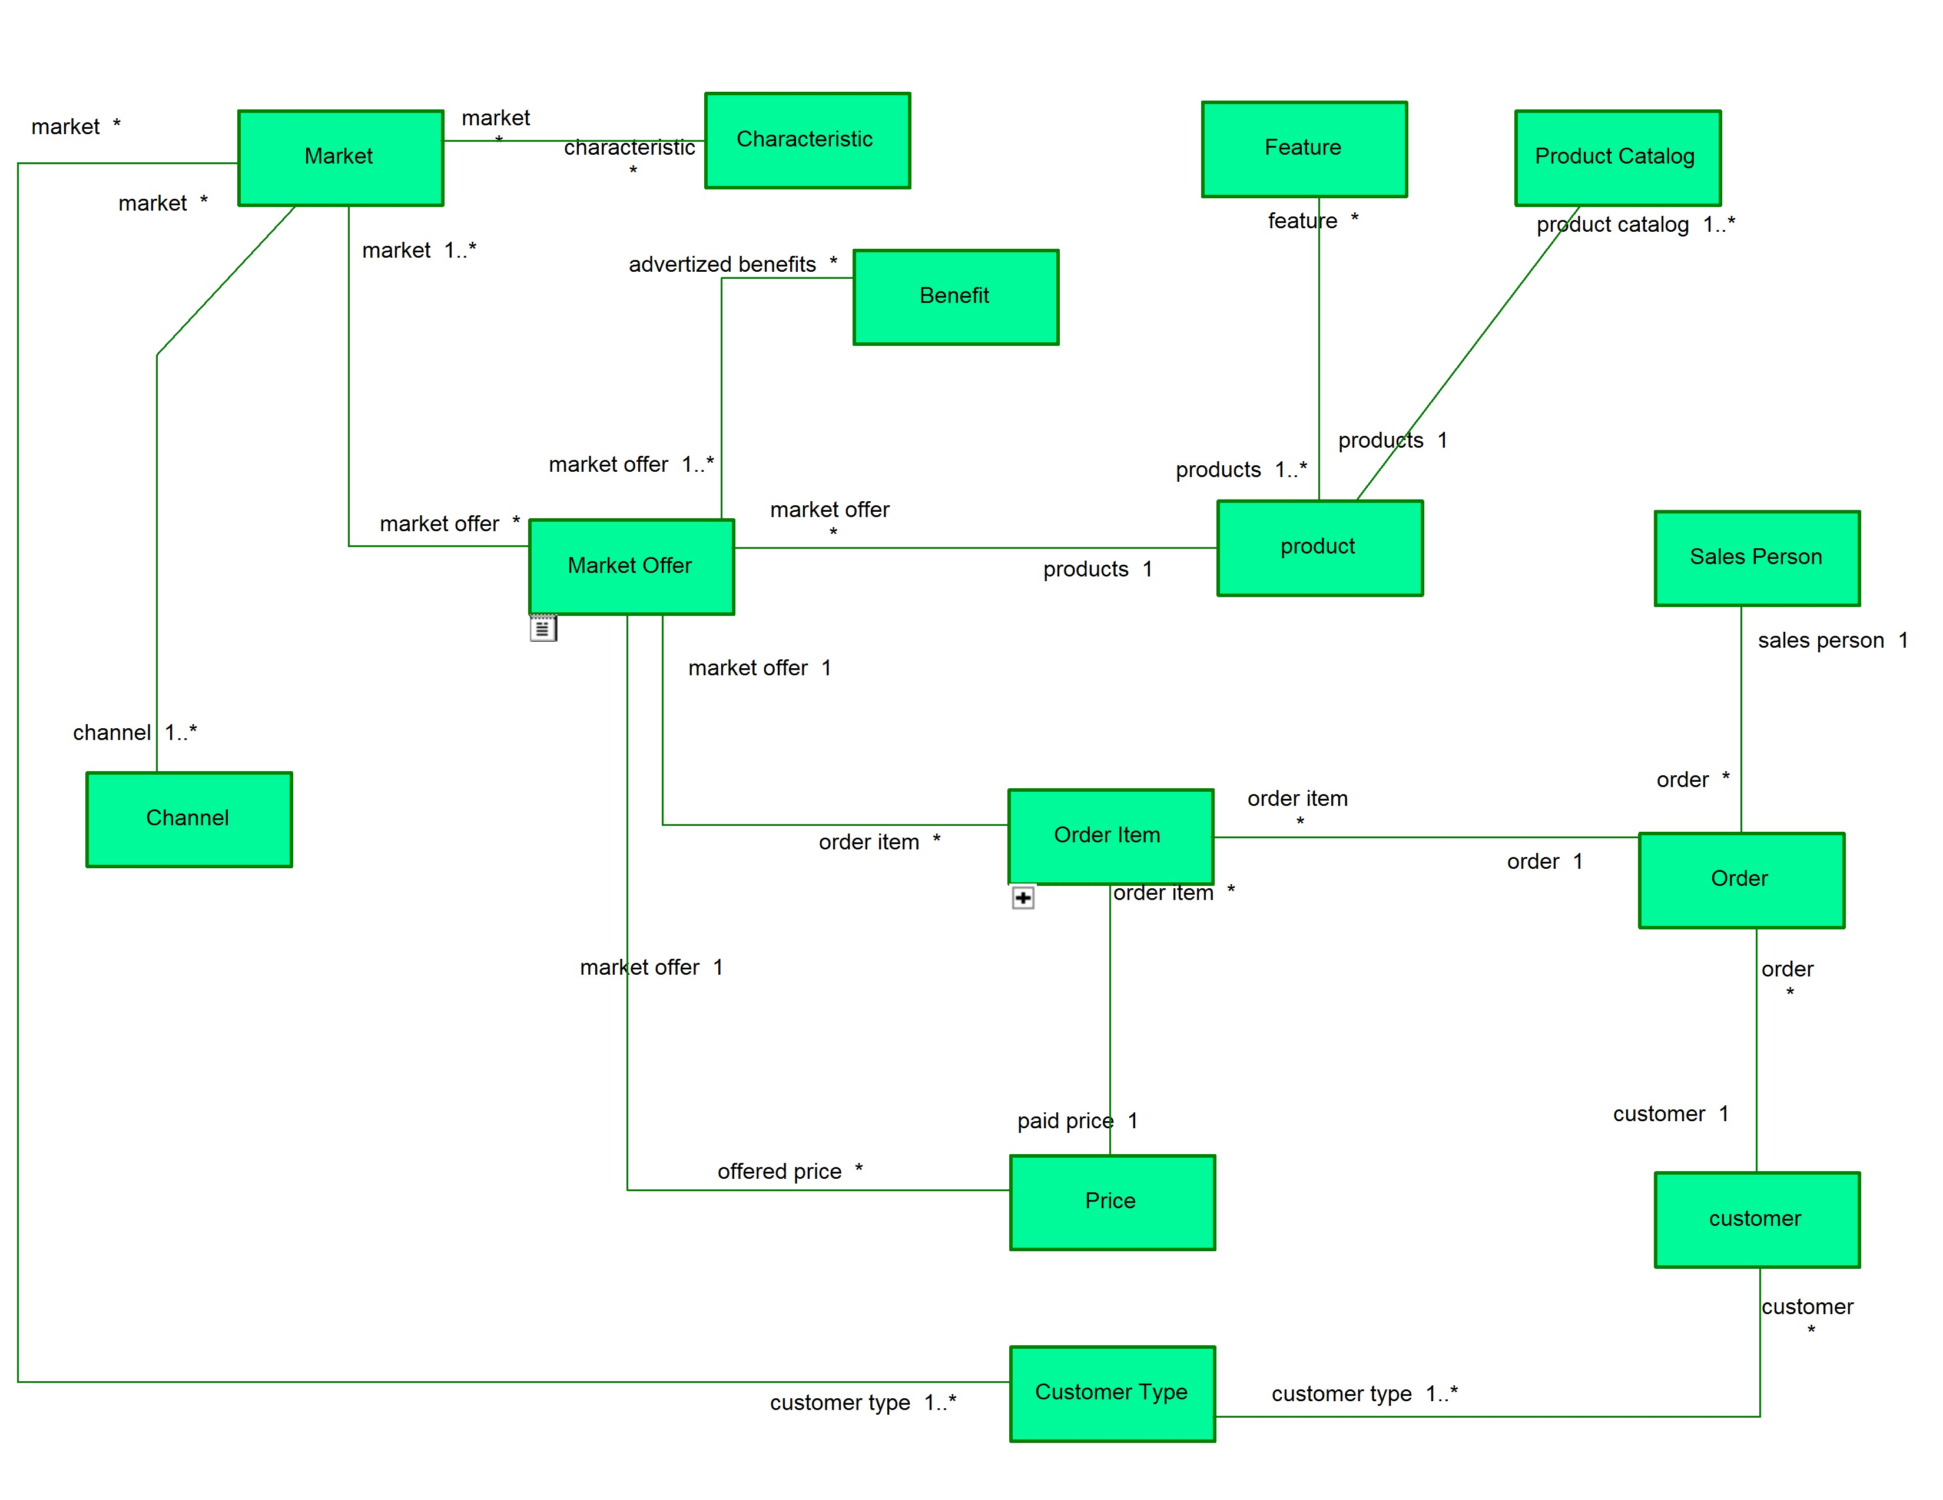

Slide 31
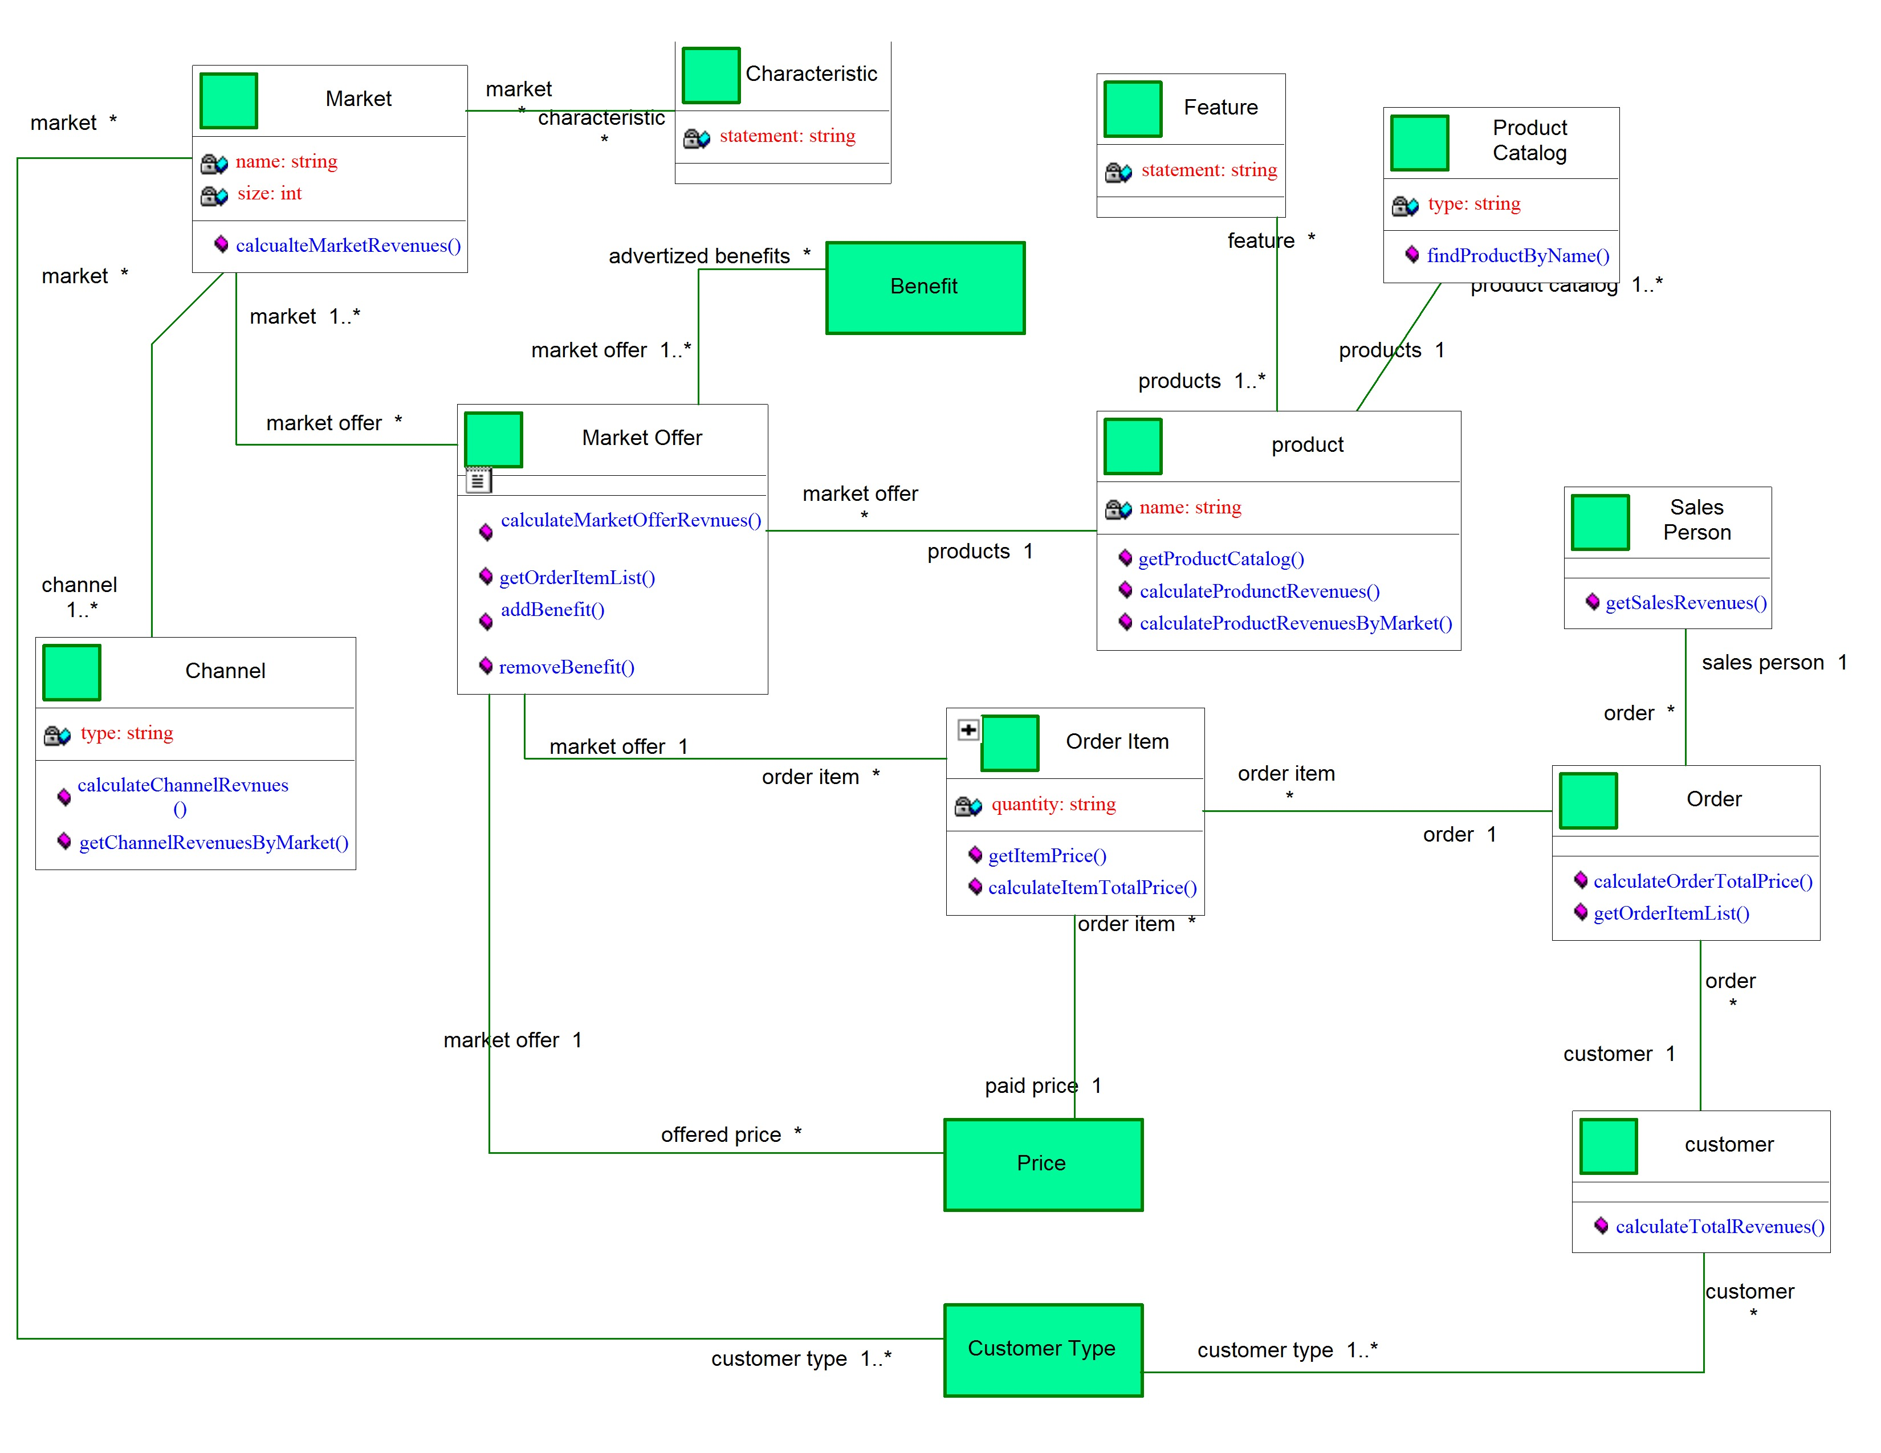

Slide 32
Department related questions start here
Student related questions start here

Slide 33
Create Product Class under the business package
Product
name
price
availability
description
Attribute
Method

Slide 34
ProductCatalog Class under the business package
ProductCatalog
name: String
lastUpdated: String
description: String
products: List of products
Attribute
newProduct(): returns a new empty product
FindProduct(ProductId:String)
getProductList(): returns list of all products
Method

Slide 35
ProductCatalog Class under the business package
ProductCatalog
The newProduct() method does the following:
Uses the java new operator to create a product object
Saves internally as part of a list
Returns the obejct to the caller (requester)
newProduct(): returns a new empty product

Slide 36
How the product catalog will flow through the screens?
When the mainjframe is first executed, we create an object of
type productcatalog
We keep the product catalog object in the MainJFrame for the
duration of the application
We user wants to add a product we send the product catalog
object to the add product screen
The product screen will use the product catalog object to
create new product and fill it with input from the user.
The catalog should how to save the newly created product in
its list of products

Slide 37
Create product catalog and save it here in a reference variable
Jframe (MainJFrame)
Product Catalog
Create Product JPanel
Product Catlog
Input fields
NameTextField
PriceTextField
Product
The product catalog object here is passed as a parameter from the MainJFrame (both are the same object)
Product

Slide 38
Create product catalog and save it here in a reference variable
Jframe (MainJFrame)
Product Catalog
View products JPanel
Product Catlog
Product
The product catalog object here is passed as a parameter from the MainJFrame (both are the same object)
Product 1
Product 2
Product 3
Product 4
Product

